Slide 4

Using github

Slide 5
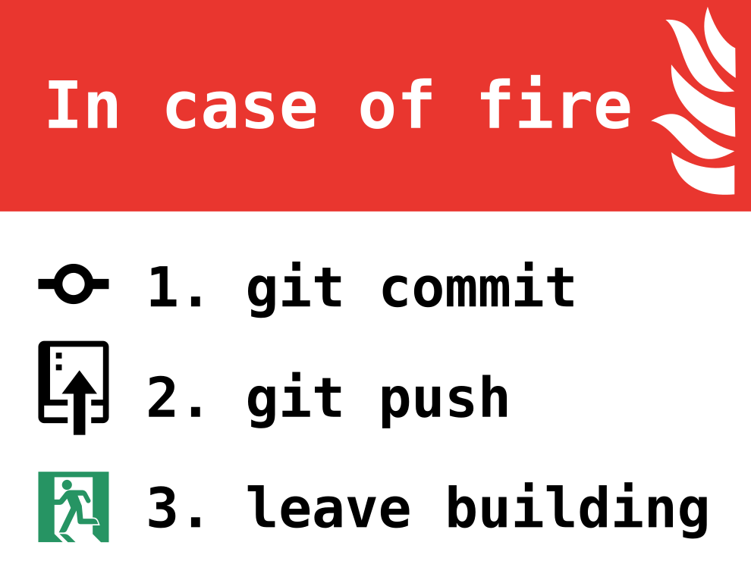
What is github and why use it?
Version control platform
If you work on a relatively large code base as in a thesis project – errors occur
A way to know what worked before

Slide 6
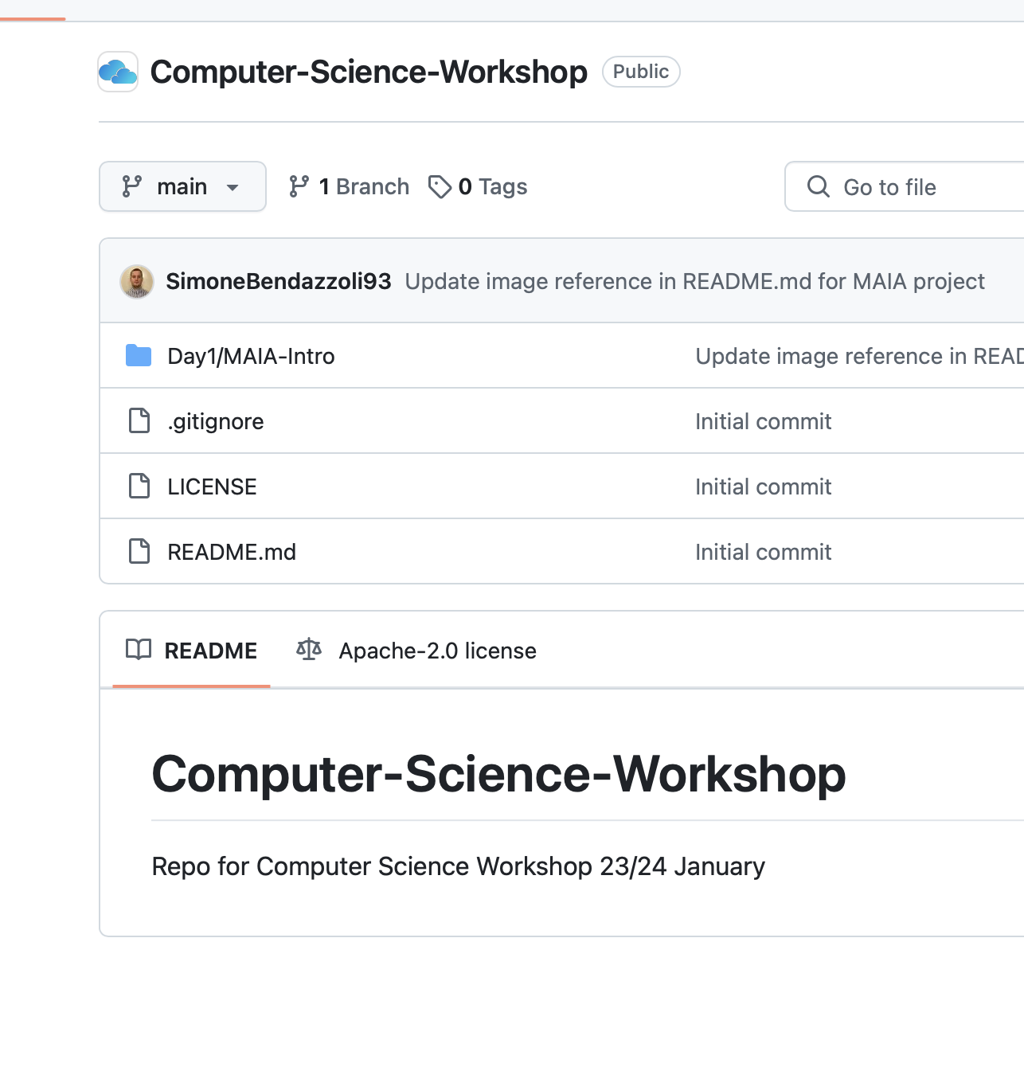
Github structure
Code is structured in repositories under users/teams
Repositories has folders and files
.. and branches – parallel tracks of the same code

Slide 7
Git basic commands – to be run in your terminal
git clone – copy the repo to you local folder
Make your changes to whatever file
git status – check what has changed compared to previous commit
git add - add the files for git to keep track of, e.g. git add –A to add everything
git commit – m "message here" - to add the changes to the tree of changes github maintains
git push – to push the changes to the online repository

Slide 8
Git better practices - branches
Working on things in parallel
Create: git branch branch_name
Switch branch with: git checkout branch_name
Add your changes to the branch: git status, git add, git commit after changing your code
Push the code to github.com under the branch:
git push –set-upstream branch_name

Slide 9
Git better practices – forks and pull requests
Scenario: you see some nice repository on github and you want to use the repo and maybe even contribute to it
Click the "fork" to create a copy of the repo on your page
Clone the repo from your own user
Make your changes and push to your repo
Go to the original repository and make a pull request

Slide 10
Try it out yourself
Create a fork of: https://github.com/kthcloud/Computer-Science-Workshop/
Clone the repo to your local computer
Create a branch with your name
Add a txt file using the terminal with the content of the request: curl https://httpbin.org/uuid
Push to the branch in your fork
Make a pull request to the repo on KTHCloud

